Slide 1
How to share a new record in the Member Institution with the Network Zone institution
when the same record does not already exist in the Network Institution
Yoel Kortick
Senior Librarian

Slide 2
Agenda
Introduction
Sharing a new record in the Member Institution with the Network Zone
2

Slide 3
Introduction

Slide 4
Introduction
In this presentation we will
    Share a new record in the Member Institution with the Network Zone institution when the same record does not already exist in the Network institution

Slide 5
Introduction
In the example here we have a Network Zone and three Member Institutions:
Member / Network | Name | Inst. Code
Network | Ex Libris University Consortium | EXLDEMO2_INST
Member | Alma University | EXLDEV1_INST
Member | Open University | EXLDEMO3_INST
Member | University of Knowledge | EXLDEMO1_INST

Slide 6

Introduction
Network Zone
Ex Libris University Consortium
Member Institution
Alma University
Member Institution
Open University
Member Institution
University of Knowledge

Slide 7
Sharing a new record in the Member Institution with the Network Zone

Slide 8
Sharing a new record in the Member Institution with the Network Zone
We will now share a new record in the Member Institution with the Network Zone institution when the same record does not already exist in the Network Zone institution.
In the example here we have “Local” defined in “Placement Options” for “Placement of new records and templates” which is defined per user in the Metadata Editor of the Member Institution at “New > Placement Options”.
If “Network” (instead of “Local”) was defined for “Placement of new records and templates” then this workflow would be unnecessary.
This is because when “Network” is defined for “Placement of new records and templates” then new records would in any case be saved in the Network.
For in depth details of this definition see How to Control Where to Save New Records Templates and Rules From a Member Institution of a Network Zone Consortia.pptx

Slide 9
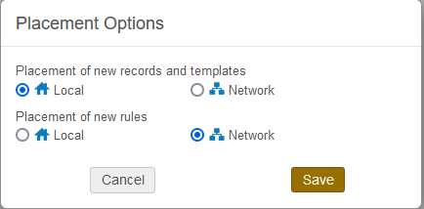
Sharing a new record in the Member Institution with the Network Zone
As stated: In the example here we have “Local” defined in “Placement Options” for “Placement of new records and templates” which is defined per user in the Metadata Editor of the Member Institution at “New > Placement Options”.

Slide 10
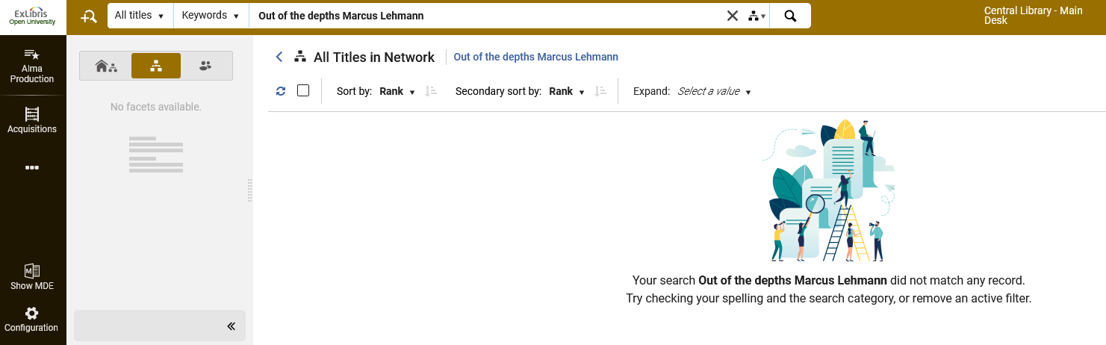
Sharing a new record in the Member Institution with the Network Zone
The new record we will catalogue in Member Institution Open University is title “Out of the depths” by author “Lehmann, Marcus”.
First we check to confirm that it does not already exist in the Network Zone institution and then we will catalogue a new record in our member institution.
We have confirmed that it does not already exist in the network zone institution

Slide 11
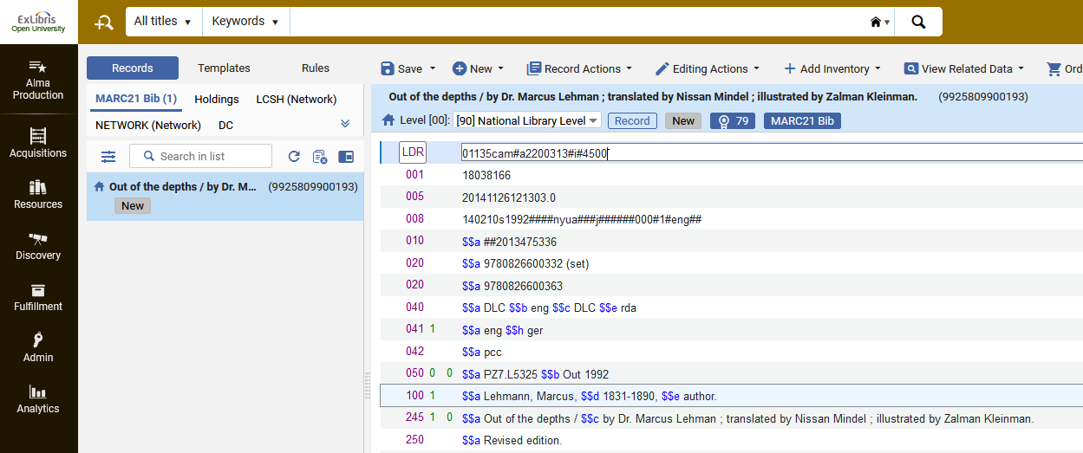
Sharing a new record in the Member Institution with the Network Zone
Because it does not already exist o the Network Zone we catalog it (from scratch or by searching a resource) in the Member Institution
We will save the record and add inventory
We are in the Member Institution

Slide 12
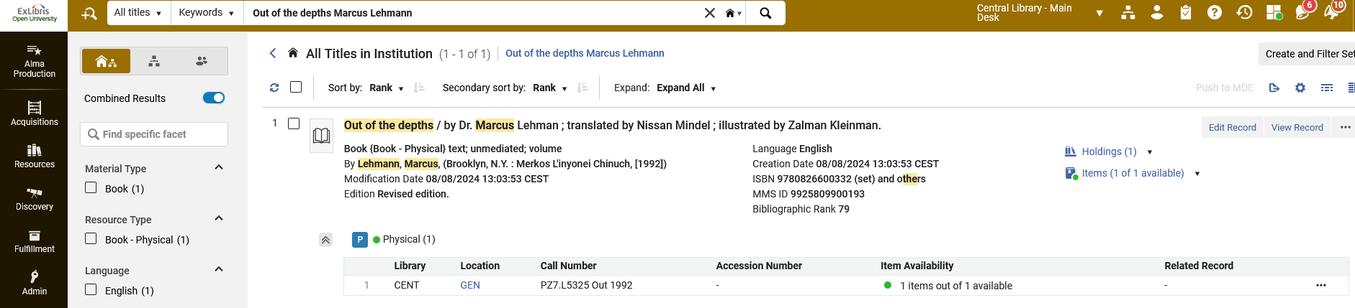
Sharing a new record in the Member Institution with the Network Zone
The record is in the Member Institution Open University and is not linked to the network
If the record were linked to the Network Zone institution, then we would have a relevant icon here

Slide 13
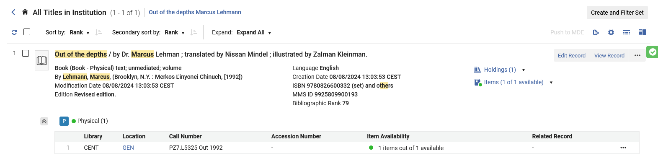
Sharing a new record in the Member Institution with the Network Zone
    We edit the record (or if the record is still open in the Metadata Editor, we could just go to the metadata Editor, as the step of searching for it was just to show how the record appears in search)

Slide 14
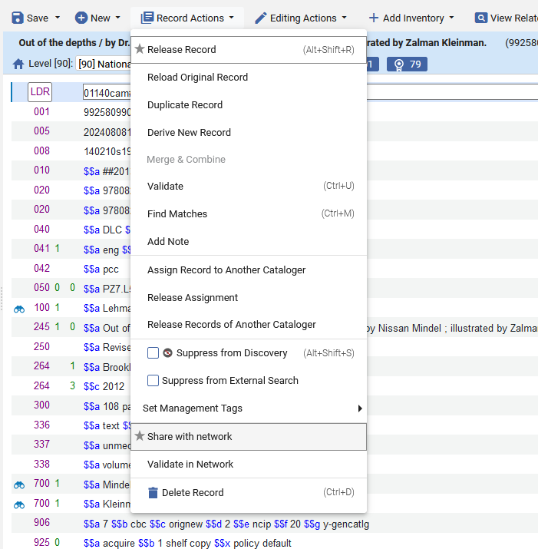
Sharing a new record in the Member Institution with the Network Zone
    We Share with Network

Slide 15
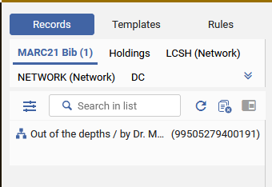
Sharing a new record in the Member Institution with the Network Zone
    We see in the Metadata Editor that the record is shared with the Network Zone institution

Slide 16
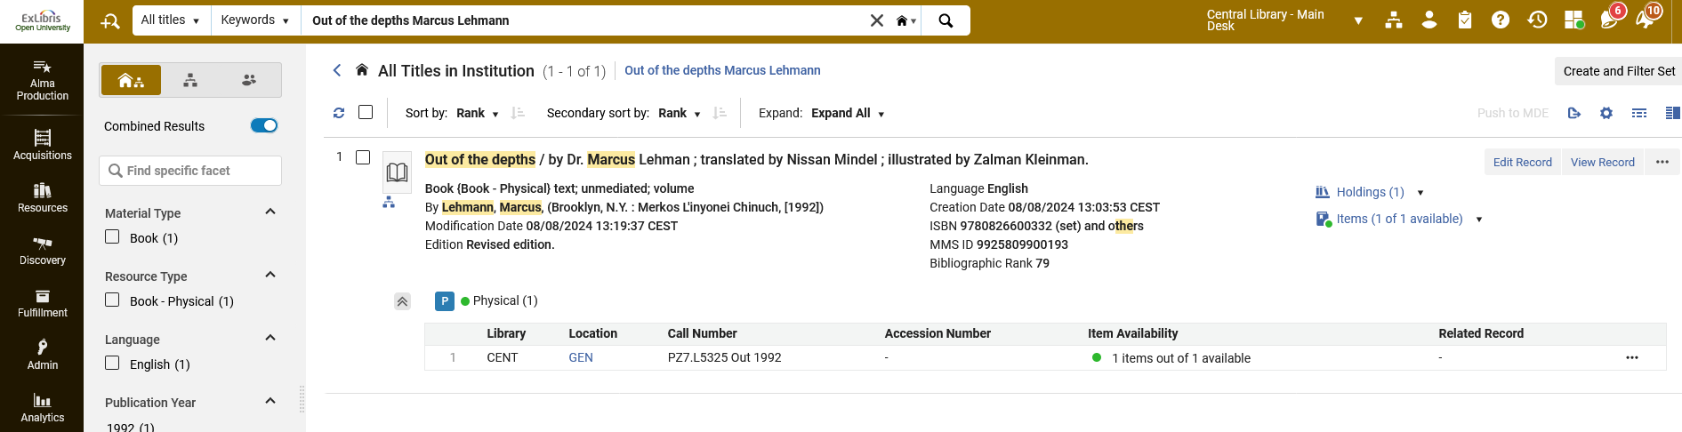
Sharing a new record in the Member Institution with the Network Zone
    We see in the repository search in the Member Institution scope that the record is shared with the Network Zone institution
Now we have the relevant icon here because the record is linked to the Network Zone institution.

Slide 17
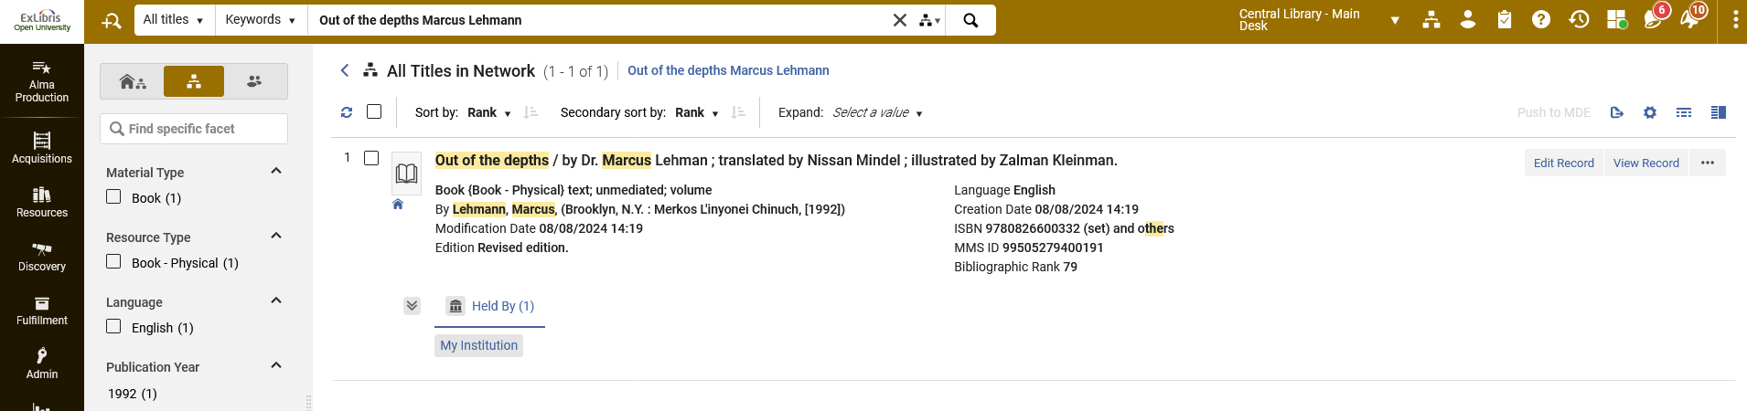
Sharing a new record in the Member Institution with the Network Zone
We see in the repository search in the Network Zone scope that the record is shared with the Member Institution and Held By My Institution.

Slide 18
Thank You

